Slide 1


Slide 2
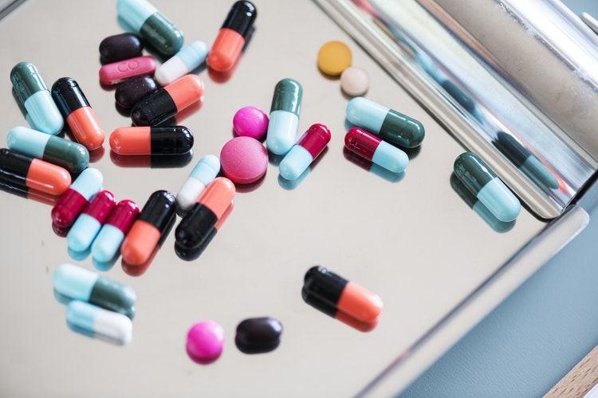
343 Billion PKR
Pakistan Medical Assositation Drug Report 2015

Slide 3
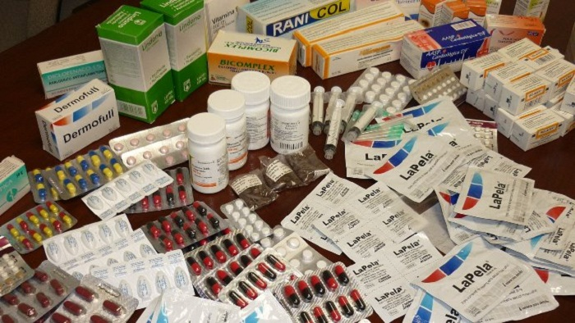
Fake medicine captures around 50% of the market
http://citeseerx.ist.psu.edu/viewdoc/download?doi=10.1.1.470.2406&rep=rep1&type=pdf

Slide 4
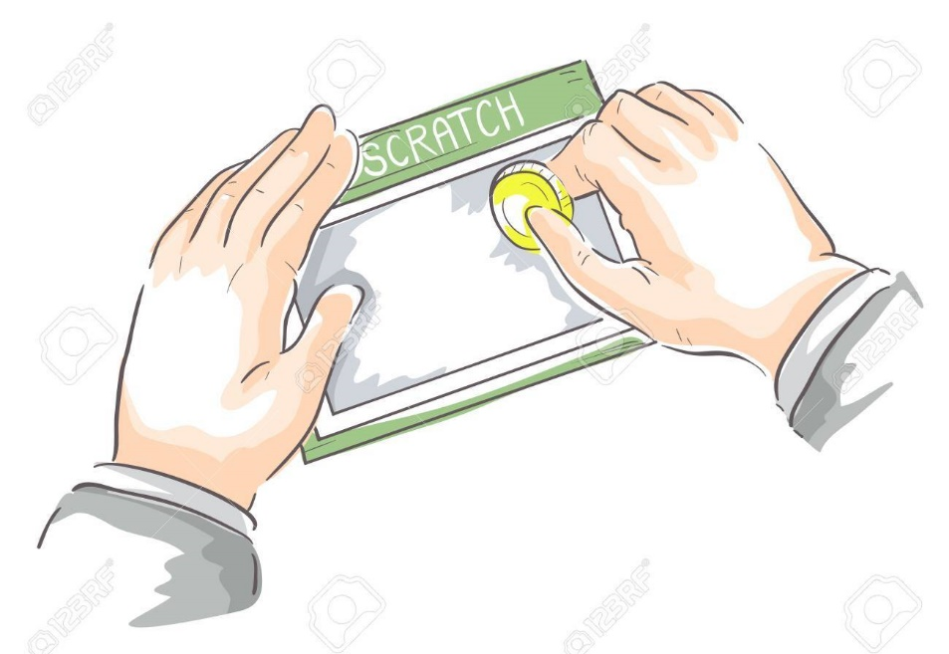
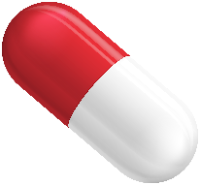
Solution: Validation of medicine by scratching a code on the medicine box and checking it on mobile

Slide 5
Existing Practice
Manufacturer
Distributor
Retailer
Consumer
What We Will Do
Manufacturer + We as a Distributor
Retailer
Consumer

Slide 6
How the business is sustainable
Distribution Profit
Medicine Cost + scratch code cost+1% of Total Retail Price
Example:
100+2+1=103 rupees

Slide 7
Thing to Highlight

Slide 8
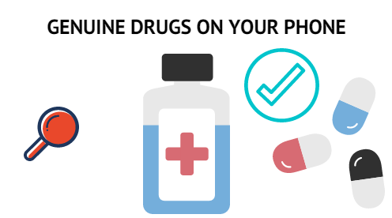
WHY PEOPLE WILL TRUST US?
Manufacturer 2x sales boost and reputation
Retailer becomes authenticated’
For Consumer

Slide 9
Competition already?
No system for validation in Pakistan except a Manual System
M-pedigree

Slide 10

OUR VISION
Erdicate Sale of Fake Medicine in Pakistan

Slide 11
